Slide 1
REVIEW -1
COURSE : CLOUD COMPUTING
COURSE CODE: SWE4002
FACULTY: DR V MUTHUMANIKANDAN

Slide 2
TEAM MEMBERS:
Reshma.P - 17MIS1009
Nitya sree.P - 17MIS1007
N Nimisha Yadav -17MIS1183

Slide 3
PROJECT TITLE:
A Cloud based personalized recommendation system

Slide 4
INTRODUCTION:
The cloud based personalized recommendation system , takes the current books, songs, movies present in your account by the ratings given to them and recommends new books , songs or movies based on the user interests.
By using the techniques like content based and collaborative based, deep learning and matrix factorization techniques

Slide 5
OBJECTIVES:
The main objective is to get all recommendation about different books, movies, songs in one place ,to be more accurate ,giving ratings to them and have a faster response time by using various latest algorithms like deep learning and matrix factorzation.

Slide 6
LITERATURE SURVEY:
Paper | Journal | Title (year) | Explanation | Merits | Demerits
https://pdfs.semanticscholar.org/1e6b/0c387c62b3dfdde8b8226fc206e41e72e7d9.pdf | https://pdfs.semanticscholar.org/595d/6f891d2c12123e69151548b52de5c71ae632.pdf | Recommender systems (March 2015) | The paper reviews state of art in recommender systems algorithms and techniques which is necessary to identify the gaps and improvement areas. | This work provided a broad overview of available recommender systems techniques with their pros and cons. In addition to that shortcomings of each technique | Current recommender systems have shortcomings such as cold start, sparsity, and lack of enough context awareness.

Slide 7
Paper | Journal | title | explanation | merits | demerits
 |  |  | In addition to that, we provide possible solutions to overcome shortages and known issues of recommender systems as well as discussing about recommender systems evaluation methods and metrics in details. | have been discussed and some suggestions have been made which can be leveraged to improve quality of recommendations. Finally, methods to evaluate | These issues could be partially addressed by taking applying some role enforcement mechanism, crowd sourcing, and taking further contextual parameters into account. These are the open areas in recommender systems.

Slide 8
Paper | Journal | Title | Explanation | Merits | Demerits
 |  |  |  | recommender systems have been discussed. Recommender systems are closely related to information filtering with the idea of having personalized decision guides for users. There are mainly three algorithmic techniques for computing recommendations.

Slide 9
Paper | Journal | Title (year) | Explanation | Merits | Demerits
https://papers.nips.cc/paper/5004-deep-content-based-music-recommendation.pdf | https://papers.nips.cc/paper/5004-deep-content-based-music-recommendation.pdf | Deep content-based music recommendation(2012) | In this paper, a latent factor model for recommendation is proposed and predict the latent factors from music audio when they cannot be obtained from usage data. | The use of deep convolutional neural networks to predict latent factors from music audio when they cannot be obtained from usage data. | A lot of characteristics of songs that affect user preference cannot be predicted from audio signals,

Slide 10
Paper | Journal | Title | Explanation | Merits | Demerits
 |  |  | Which compares a traditional approach using a bag-of-words representation of the audio signals with deep convolutional neural networks, and evaluate sthe predictions quantitatively and qualitatively on the Million Song Dataset. | Evaluated the predictions by using them for music recommendation on an industrial-scale dataset. Even though a lot of characteristics of songs that affect user preference cannot be predicted from audio signals, the resulting recommendations seem to be sensible. conclude s that predicting latent factors from music audio is a viable method for recommending new and unpopular music.

Slide 11
Paper | Journal | Title (year) | Explanation | Merits | Demerits
http://sonyis.me/paperpdf/frp1159-songA-www-2015.pdf | http://sonyis.me/paperpdf/frp1159-songA-www-2015.pdf | A Multi-View Deep Learning Approach for Cross Domain User Modeling in Recommendation Systems (2015) | We propose to use a rich feature set to represent users, according to their web browsing history and search queries. We use a Deep Learning approach to map users and items to a latent space where | presented a general recommendation framework that uses deep learning to match rich user features to items features. We also showed how to extend this framework | entire set of user features can be used for training without dimension reduction. We also aim at adding more domains into our multi-view framework and further

Slide 12
Paper | Journal | Title (year) | Explanation | Merits | Demerits
 |  |  | the similarity between users and their preferred items is maximized. We extend the model to jointly learn from features of items from different domains and user features by introducing a multi-view | to combine data from different domains to further improve the recommendation quality. | analysis its performance in details. Another important direction is to investigate how to incorporate collaborative filtering with our approach which currently running only as content-based filtering approach.

Slide 13
Paper | Journal | Title (year) | Explanation | Merits | Demerits
 |  |  | Deep Learning model. We show how to make this rich-feature based user representation scalable by reducing the dimension of the inputs and the amount of training data.

Slide 14
Paper | Journal | Title (year) | Explanation | Merits | Demerits
https://arxiv.org/abs/1703.04247 | https://arxiv.org/abs/1703.04247 | DeepFM: A Factorization-Machine based Neural Network for CTR Prediction (2017) | In this paper, its shown that it is possible to derive an end-to-end learning model that emphasizes both low- and high-order feature interactions. The proposed model, DeepFM, combines the power of factorization | Learning sophisticated feature interactions behind user behaviors is critical in maximizing CTR for recommender systems. | Despite great progress, existing methods seem to have a strong bias towards low- or high-order interactions, or require expertise feature engineering

Slide 15
Paper | Journal | Title (year) | Explanation | Merits | Demerits
 |  |  | machines for recommendation and deep learning for feature learning in a new neural network architecture. Compared to the latest Wide \& Deep model from Google, DeepFM has a shared input to its "wide" and "deep" parts, with no need of feature engineering besides raw features. Comprehensive experiments are conducted to demonstrate the effectiveness and efficiency of DeepFM over the existing models for CTR prediction, on both benchmark data and commercial data.

Slide 16
Paper | Journal | Title (year) | Explanation | Merits | Demerits
https://static.googleusercontent.com/media/research.google.com/en//pubs/archive/45530.pdf | https://static.googleusercontent.com/media/research.google.com/en//pubs/archive/45530.pdf | Deep Neural Networks for YouTube Recommendations(2018) | The paper is split according to the classic two-stage information retrieval dichotomy: first, they detailed a deep candidate generation model and then describe d a separate deep ranking model. Also provided practical | Deep collaborative filtering model is able to effectively assimilate many signals and model their interaction with layers of depth, | latch behavior and preventing leakage of future information. Withholding discrimative signals from the classifier was also essential to

Slide 17
Paper | Journal | Title (year) | Explanation | Merits | Demerits
 |  |  | lessons and insights derived from designing, iterating and maintaining a massive recommendation system with enormous userfacing impact. | outperforming previous matrix factorization approaches used at YouTube | achieving good results - otherwise the model would overfit the surrogate problem and not transfer well to the homepage

Slide 18
Paper | Journal | Title (year) | Explanation | Merits | Demerits
https://arxiv.org/pdf/1606.07659.pdf | https://arxiv.org/pdf/1606.07659.pdf | Hybrid Recommender System based on Autoencoders | In this paper, we gather the best practice from the literature to achieve this goal. We first highlight the link between these autoencoder based approaches and MF. Then, we refine the training | highlight the connections between autoencoders and matrix factorization for matrix completion. We pack some modern training techniques - | Other extensions could use recurrent networks to grasp the sequential aspect of the collection of ratings.

Slide 19
Paper | Journal | Title (year) | Explanation | Merits | Demerits
 |  |  | Other extensions could use recurrent networks to grasp the sequential aspect of the collection of ratings.

Slide 20
Paper | Journal | Title (year) | Explanation | Merits | Demerits
http://dm.postech.ac.kr/~cartopy/ConvMF/ | http://dm.postech.ac.kr/~cartopy/ConvMF/ | Convolutional Matrix Factorization for Document Context-Aware Recommendation (2012) | This paper proposes a novel context-aware recommendation model, convolutional matrix factorization (ConvMF) that integrates convolutional neural network (CNN) into probabilistic matrix factorization (PMF). | Shows the overall rating prediction errors of five methods on each test set. ConvMF and ConvMF+ achieve significant improvements on all the datasets. | a high value of λ_{v} leads that ConvMF and ConvMF+ try to exploit description documents of items more than ratings.

Slide 21
Paper | Journal | Title (year) | Explanation | Merits | Demerits
 |  |  | Consequently, ConvMF captures contextual information of documents and further enhances the rating prediction accuracy. Our extensive evaluations on three real-world datasets show that ConvMF significantly outperforms the state-of-the-art recommendation models even when the rating data is extremely sparse. We also demonstrate that ConvMF successfully captures subtle contextual difference of a word in a document.

Slide 22
Paper | Journal | Title (year) | Explanation | Merits | Demerits
https://pdfs.semanticscholar.org/1e6b/0c387c62b3dfdde8b8226fc206e41e72e7d9.pdf | Hofmann, T. (2014). Latent semantic models for collaborative filtering. ACM Transactions on Information Systems (TOIS), 22(1), 89-115. | A Literature Review on Recommender Systems Algorithms, Techniques and Evaluations (2014) | Collaborative Filtering Techniques Collaborative filtering could be implemented in the forms of memory-based (usually userbased) or model-based. | No domain knowledge necessary We don't need domain knowledge because the embeddings are automatically learned. | Hard to include side features for query/item Side features are any features beyond the query or item ID.

Slide 23
Paper | Journal | Title (year) | Explanation | Merits | Demerits
 |  |  | In this approach recommendations are more accurate but when system database is very large, this approach is almost impractical due to existed limitation in primary memory for keeping the database. Model-based approach on the other hand does not have the aforementioned limitations of memory-based. In this method, instead of keeping the entire database in memory just specific collection of data which are already trained using machine learning methods are kept in memory.

Slide 24
Paper | Journal | Title (year) | Explanation | Merits | Demerits
https://pdfs.semanticscholar.org/1e6b/0c387c62b3dfdde8b8226fc206e41e72e7d9.pdf | Adomavicius, G., Sankaranarayanan, R., Sen, S., & Tuzhilin, A. (2015). Incorporating contextual information in recommender systems using a multidimensional approach. ACM | Research-paper recommender systems: a literature survey (2015) | Memory-based Collaborative Filtering A memory-based CF (nearest-neighbor) approach, mostly called as a form of implementation of the “Word of Mouth” phenomenon (Jin, Chai & Si, 2004) since the entire user database with their preferences are kept in memory. For each prediction computation is performed K. Madadipouya, S. Chelliah - A Literature Review on Recommender Systems Algorithms, Techniques and Evaluations 113 on the whole database. This method could predict a user interests on a specific item based on the rating information of similar user profiles. | Serendipity The model can help users discover new interests. | Heuristics to generate embeddings of fresh items. If the system does not have interactions, the system can approximate its embedding by averaging the embeddings of items from the same category, from the same uploader (in YouTube), and so on.

Slide 25
Paper | Journal | Title (year) | Explanation | Merits | Demerits
 |  |  | It reflects where the prediction of a specific item (belonging to a specific user) is done by sorting the row vectors (user profiles) by its dissimilarity toward the user. In this method, more rating by more similar users leads to more rating prediction. Various types of memory-based recommender systems have been developed. Decker and Lenz (2007) stated that Goldberg on 1992 developed certain type of memory-based CF system which is called Tapestry. This system relies on each user to identify similar users manually.

Slide 26
Paper | Journal | Title (year) | Explanation | Merits | Demerits
Bogers, T., & Van den Bosch, A. (2012). Collaborative and content-based filtering for item recommendation on social bookmarking websites. | Cano, P., Koppenberger, M., & Wack, N. (2012November). Content-based music audio recommendation. | Content-based Filtering (2012) | Content-based Filtering Due to information overloading in the web which is explained before, different approaches provided to tackle with this issue. One common method that used to automatically categorize, filter, and provide recommendations to users is content-based filtering (Ferman et al., 2002). This method compares the available items with a user’s profile and item rated previously to find the best match to generate recommendations. This technique is different from IF and IR methods. | The model doesn't need any data about other users, | The model can only make recommendations based on existing interests of the user. In other words, the model has limited ability to expand on the users' existing interests.

Slide 27
Paper | Journal | Title (year) | Explanation | Merits | Demerits
 |  |  | For instance, information retrieval allows users to specify their interest explicitly in form of keywords. This means that users retrieve their needed information, however, content-based filtering is based on finding suitable information automatically. In this technique, at first, data about the target user is gathered. This data could be acquired explicitly and implicitly with doing analysis on the user profile. Then based on the analysis the user’s tastes identified and as a result a set of items will be recommended to the users.

Slide 28
Paper | Journal | Title (year) | Explanation | Merits | Demerits
http://aircconline.com/acii/V3N1/3116acii03.pdf | P. Resnick and H. R. Varian, “Recommender systems,” Communications of the ACM, vol. 40, no. 3, pp. 56–58, 1997. | A LITERATURE SURVEY ON RECOMMENDATION SYSTEM BASED ON SENTIMENTAL ANALYSIS(2014) | Hybrid Collaborative Filtering Techniques In hybrid recommender system, different techniques of collaborative approaches and other recommender techniques (usually content based approaches), combined to get better results. Various problems like cold-start, data sparsity and scalability can be avoided by using hybrid approach . | Great starting point | No domain knowledge necessary. Serendipity. Cannot handle fresh items. Hard to include side features for query/item.

Slide 29
Paper | Journal | Title (year) | Explanation | Merits | Demerits
 |  |  | There are different ways of combining CF with other recommender techniques which are following: • Hybrid Recommenders Incorporating CF and Content-Based Features • Hybrid Recommenders Combining CF and Other Recommender Systems • Hybrid Recommenders Combining CF Algorithms [37

Slide 30
Paper | Journal | Title (year) | Explanation | Merits | Demerits
http://aircconline.com/acii/V3N1/3116acii03.pdf | P. Resnick and H. R. Varian, “Recommender systems,” Communications of the ACM, vol. 40, no. 3, pp. 56–58, 1997. | Context-Based Recommender Syste(2015)m | METHOD DESCRIPTION REFERENCES Hidden Markov Model Improved version of a location recommender system by implementing Decision Tree (DT) along with discrete Hidden Markov Model (HMM).Together HMM and DT differentiate between transport modes and reduce noise. Norma Saiph Savage Maciej Baranski Norma Elva Chavez Tobias Höllerer[34] | is that they provide personalization for customers of e-commerce, promoting one-to-one marketing. Amazon, | Scalability: Nearest neighbor algorithms require computation that grows with both the number of users and the number of items.

Slide 31
Paper | Journal | Title (year) | Explanation | Merits | Demerits
 |  |  | Multidimensional approach It provides additional contextual information on user and item, and also supports multiple Dimensions, profiling information, and hierarchical aggregation of recommender system.

Slide 32
Paper | Journal | Title (year) | Explanation | Merits | Demerits
https://link.springer.com/referenceworkentry/10.1007%2F978-3-319-17885-1_1580 | https://link.springer.com/referenceworkentry/10.1007%2F978-3-319-17885-1_1580 | Link analysis-based recommendation Zheng (2009) | proposed a link analysis-based recommendation system for recommending experienced users and popular locations. | Location based recommendation algorithm proposed is very accurate | But the system is unable to provide personalized recommendations, and is preferred only in cases where generic recommendations are anticipated.

Slide 33
Paper | Journal | Title (year) | Explanation | Merits | Demerits
https://www.researchgate.net/publication/2378325_Knowledge-Based_Recommender_Systems | https://www.researchgate.net/publication/2378325_Knowledge-Based_Recommender_Systems | Knowledge-based recommendation Burke (2000) | proposed a knowledge-based recommendation system for recommending restaurants to users. | The system allows users to interact with it by getting them to specify their requirements, and then refining them on the go. | the system is focuses too much on personalised recommendation and hence finding new suggestion based on peer review is hard

Slide 34
Paper | Journal | Title (year) | Explanation | Merits | Demerits
https://www.researchgate.net/publication/2492710_Content-Boosted_Collaborative_Filtering_for_Improved_Recommendations | https://www.researchgate.net/publication/2492710_Content-Boosted_Collaborative_Filtering_for_Improved_Recommendations | Melville (2002) deploy content-boosted collaborative filtering. | The method uses the Naïve Bayes classifier for rating unrated items in the rating matrix, with the collaborative filtering technique being used for recommendation. | The system uses a CF-based recommendation system. The execution time for recommendations is short | but the cold start problem is not dealt with.

Slide 35
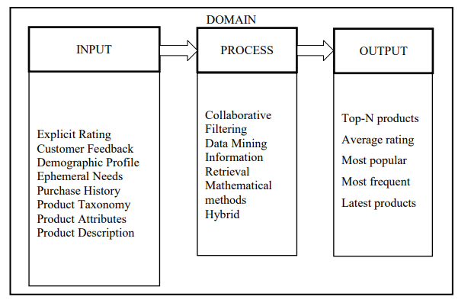
Generic Input-Process-Output Model of Recommender System

Slide 36
EXISTING SYSTEM:
The Existing system uses conventional data mining algorithms and are most specialized to cater a single need like movies alone or songs alone.
And the main module is Recommendar system, where the user can view books, movies of different categories and can rate them as per his/her likings.
Collaborative based and content based filtering techniques are used.

Slide 37
PROBLEM DEFINITION:
Recommendation system focuses on one domain alone . A user will have a good experience if it extends to more than one domain ,and accurate recommendations of books, songs, movies based on the user based on their interests.

Slide 38
PROPOSED SYSTEM:
Proposed system uses collaborative filter and deep learning algorithm and is not catered to a specialized category. Rather it focused on user and all his interest in different domain including songs, movies, books etc

Slide 39
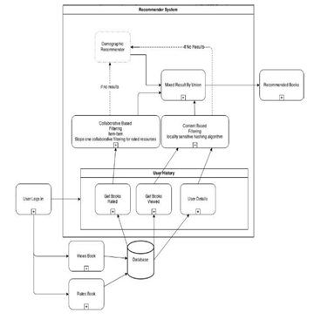
ARCHITECTURE DIAGRAM:

Slide 40
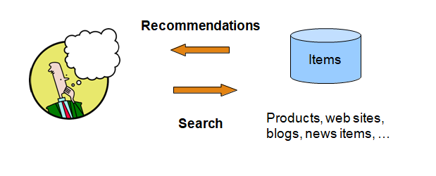
How Recommender System Works

Slide 41
MODULES AND DESCRIPTION:
The 4 recommendation systems that can be used. Here they are, in respective order of presentation:
Content-Based Filtering
Memory-Based Collaborative Filtering
Model-Based Collaborative Filtering
Deep Learning / Neural Network

Slide 42
Content Based:
The Content-Based Recommender relies on the similarity of the items being recommended. The basic idea is that if you like an item, then you will also like a “similar” item. It generally works well when it’s easy to determine the context/properties of each item.
A content based recommender works with data that the user provides, either explicitly movie ratings for the Movie Lens dataset. Based on that data, a user profile is generated, which is then used to make suggestions to the user. As the user provides more inputs or takes actions on the recommendations, the engine becomes more and more accurate.

Slide 43
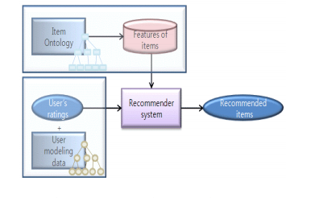
Content based recommender system

Slide 44
Content based systems focus on the features of the products and aim at creating a user profile depending on the previous reviews and also a profile of the item in accordance with the features it provides and the reviews it has received .It is observed that reviews usually contain product feature and user opinion in pairs
It is observed that users’ reviews contain a feature of the product followed by his/her opinion about the product. Content based recommendation systems help overcome sparsity problem that is faced in collaborative filtering based recommendation system.

Slide 45
In this system, the user behavior is tracked and based on the history and interaction appropriate web pages are recommended to the user. Content-based filtering is also widely used in music domain. Last.Fm (Petersen & Hansen, 2011) is a successful example of content-based recommender system in the music industry. In Last.Fm, predictions are given to users based on previous items that they rated over time.
Google News is a successful news recommender system which is used both collaborative and content-based filtering approaches to provide recommendations. In this system, the user clicks behavior is modeled in order to identify the likelihood interest of articles by the user (Liu, Dolan & Pedersen, 2010).

Slide 46
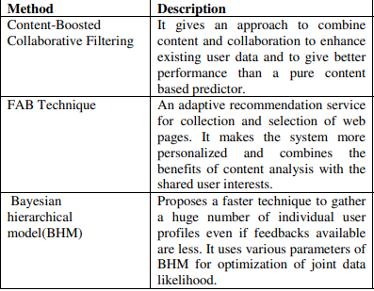
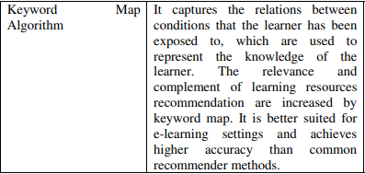
Methods

Slide 47
Collaborative:
The Collaborative Filtering Recommender is entirely based on the past behavior and not on the context. More specifically, it is based on the similarity in preferences, tastes and choices of two users. It analyses how similar the tastes of one user is to another and makes recommendations on the basis of that.
For instance, if user A likes movies 1, 2, 3 and user B likes movies 2,3,4, then they have similar interests and A should like movie 4 and B should like movie 1. This makes it one of the most commonly used algorithm as it is not dependent on any additional information.
In general, collaborative filtering is the workhorse of recommender engines. The algorithm has a very interesting property of being able to do feature learning on its own, which means that it can start to learn for itself what features to use.

Slide 48
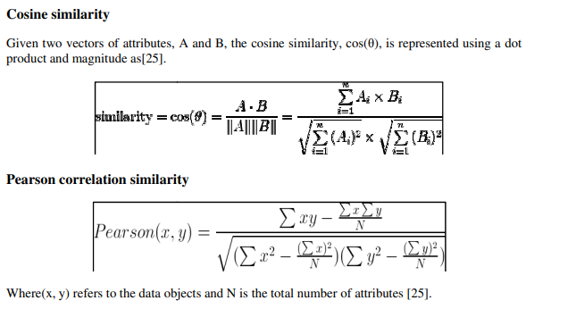

Slide 49
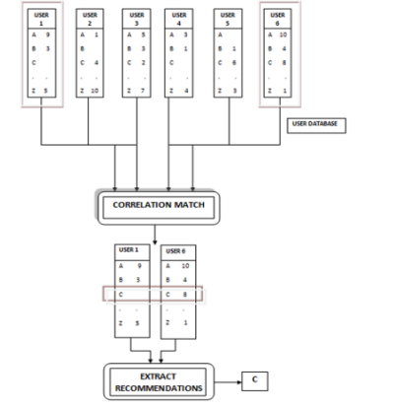
Collaborative filtering recommender system

Slide 50
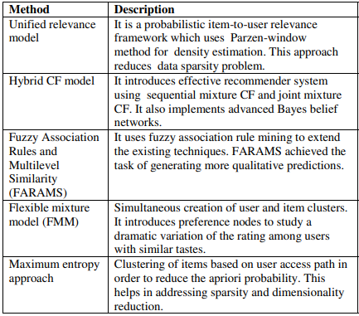
Methods

Slide 51
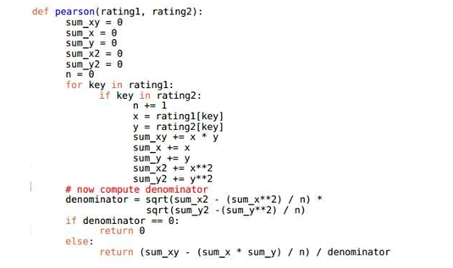
Implementation

Slide 52
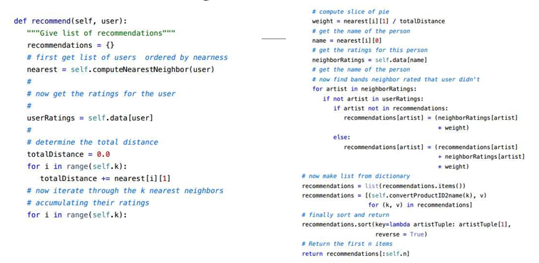
Recommending Users

Slide 53
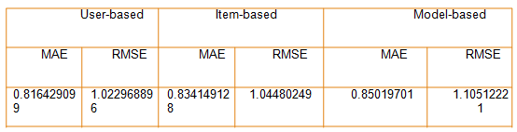
Error Calculation
Thus we find User Based Collaborative Filtering gives the best results.

Slide 54
Matrix function:
The goal of MF is to learn the latent preferences of users and the latent attributes of items from known ratings (learn features that describe the characteristics of ratings) to then predict the unknown ratings through the dot product of the latent features of users and items.
When you have a very sparse matrix, with a lot of dimensions, by doing matrix factorization, you can restructure the user-item matrix into low-rank structure, and you can represent the matrix by the multiplication of two low-rank matrices, where the rows contain the latent vector.
You fit this matrix to approximate your original matrix, as closely as possible, by multiplying the low-rank matrices together, which fills in the entries missing in the original matrix.

Slide 55
Model-Based Collaborative Filtering
Model-based techniques provide recommendations by estimating parameters of statistical models for user ratings
For example, describe an early approach to map CF to a classification problem, and build a classifier for each active user representing items as feature vectors over users and available ratings as labels, possibly in conjunction with dimensionality reduction techniques to overcome data sparsity issues.

Slide 56
Latent factor and matrix factorization models have emerged as a state of the art methodology in this class of techniques
Unlike neighborhood based methods that generate recommendations based on statistical notions of similarity between users, or between items, Latent Factor models assume that the similarity between users and items is simultaneously induced by some hidden lower-dimensional structure in the data.

Slide 57
For example, the rating that a user gives to a movie might be assumed to depend on few implicit factors such as the user’s taste across various movie genres.
Matrix factorization techniques are a class of widely successful Latent Factor models where users and items are simultaneously represented as unknown feature vectors (column vectors) wu, hi ∈ ℜk along k latent dimensions.
These feature vectors are learnt so that inner products w T u hi approximate the known preference ratings ru,i with respect to some loss measure.

Slide 58

The squared loss is a standard choice for the loss function, in which case the following objective function is minimized,

Slide 59
MEMORY BASED COLLABORATIVE
A memory-based CF (nearest-neighbor) approach, mostly called as a form of implementation of the “Word of Mouth” phenomenon (Jin, Chai & Si, 2004) since the entire user database with their preferences are kept in memory. For each prediction computation is performed K. Madadipouya, S. Chelliah - A Literature Review on Recommender Systems Algorithms, Techniques and Evaluations 113 on the whole database. This method could predict a user interests on a specific item based on the rating information of similar user profiles. It reflects where the prediction of a specific item (belonging to a specific user) is done by sorting the row vectors (user profiles) by its dissimilarity toward the user. In this method, more rating by more similar users leads to more rating prediction. Various types of memory-based recommender systems have been developed. Decker and Lenz (2007) stated that Goldberg on 1992 developed certain type of memory-based CF system which is called Tapestry. This approach mostly is used in information retrieval systems. Apart from developments which have been done by researchers, some commercial websites also have developed their own version of memory-based collaborative filtering

Slide 60
This system relies on each user to identify similar users manually. Ringo and GroupLens also developed separately developed the systems which in prediction task were automated for the first time. In GroupLens method Pearson correlation coefficient was utilized to provide automatic predictions (Nguyen & Haddawy, 1998), however, in Ringo project the main concern was testing various metrics for finding similarity between users such as correlation and means squared. In a work by Madadipouya (2015a) a new collaborative filtering proposed to take into account users’ location. The proposed method has been implemented using modified Pearson Correlation and applied in a movie dataset. The end result demonstrated some enhancement over the baseline Pearson method (Madadipouya, 2015b). Jannach (2010) proposed a similarity vector based on the cosine measure to find the similarity between the users.

Slide 61
The most successful and significance examples are Amazoon and CDNow. Several equations and formulas could be used in the memory-based approach in order to find the similarity between two users which are called mostly as similarity index function. One of the most used and the best of them is Pearson Correlation Coefficient which is used to find similarity between two users based on the rated items of the user (Jannach, 2010). In addition to that this method could be used to find missed values in the database. Equation (1) demonstrates Pearson Correlation Coefficient.

Slide 62
Deep Learning Techniques
The Math
The idea of using deep learning is similar to that of Model-Based Matrix Factorization. In matrix factorization, we decompose our original sparse matrix into product of 2 low rank orthogonal matrices. For deep learning implementation, we don’t need them to be orthogonal, we want our model to learn the values of embedding matrix itself.
The user latent features and movie latent features are looked up from the embedding matrices for specific movie-user combination. These are the input values for further linear and non-linear layers. We can pass this input to multiple relu, linear or sigmoid layers and learn the corresponding weights by any optimization algorithm (Adam, SGD, etc.).
Multilayer Perceptron (MLP) is a feed-forward neural network with multiple (one or more) hidden layers between the input layer and output layer. Here, the perceptron can employ arbitrary activation function and does not necessarily represent strictly binary classier. MLPs can be intrepreted as stacked layers of nonlinear transformations, learning hierarchical feature representations. MLPs are also known to be universal approximators.
Autoencoder (AE) is an unsupervised model aempting to reconstruct its input data in the output layer. In general, the boleneck layer (the middle-most layer) is used as a salient feature representation of the input data. ere are many variants of autoencoders such as denoising autoencoder, marginalized denoising autoencoder, sparse autoencoder, contractive autoencoder and variational autoencoder (VAE)

Slide 63
Convolutional Neural Network (CNN) is a special kind of feed forward neural network with convolution layers and pooling operations. It can capture the global and local features and significantly enhancing the efficiency and accuracy. It performs well in processing data with grid-like topology.
Recurrent Neural Network (RNN) is suitable for modeling sequential data. Unlike feed forward neural network, there are loops and memories in RNN to remember former computations. Variants such as Long Short Term Memory (LSTM) and Gated Recurrent Unit (GRU) network are open deployed in practice to overcome the vanishing gradient problem.

Slide 64
Restricted Boltzmann Machine (RBM) is a two layer neural network consisting of a visible layer and a hidden layer. It can be easily stacked to a deep net. Restricted here means that there are no intra-layer communications in visible layer or hidden layer.
Neural Autoregressive Distribution Estimation (NADE) is an unsupervised neural network built atop autoregressive model and feed forward neural networks. It is a tractable and efficient estimator for modeling data distribution and densities.
Adversarial Networks (AN) is a generative neural network which consists of a discriminator and a generator. The two neural networks are trained simultaneously by competing with each other in a minimax game framework.

Slide 65
Attentional Models (AM) are differentiable neural architectures that operate based on so content addressing over an input sequence (or image). Attention mechanism is typically ubiquitous and was incepted in Computer Vision and Natural Language Processing domains. However, it has also been an emerging trend in deep recommender system research.
Deep Reinforcement Learning (DRL) Reinforcement learning operates on a trial-and-error paradigm. e whole framework mainly consists of the following components: agents, environments, states, actions and rewards. e combination between deep neural networks and reinforcement learning formulate DRL which have achieved human-level performance across multiple domains such as games and self driving cars. Deep neural networks enable the agent to get knowledge from raw data and derive efficient representations without handcrafted features and domain heuristics.

Slide 66
ALGORITHMS:
Pearson correlation:
Similarity between two users (and their attributes, such as articles read from a collection of blogs) can be accurately calculated with the Pearson correlation. This algorithm measures the linear dependence between two variables (or users) as a function of their attributes. But it doesn't calculate this measure over the entire population of users. Instead, the population must be filtered down to neighbourhoods based on a higher-level similarity metric, such as reading similar blogs. The Pearson correlation, which is widely used in research, is a popular algorithm for collaborative filtering.
Clustering algorithms:
Clustering algorithms are a form of unsupervised learning that can find structure in a set of seemingly random (or unlabeled) data. In general, they work by identifying similarities among items, such as blog readers, by calculating their distance from other items in a feature space. The number of independent features defines the dimensionality of the space. If items are "close" together, they can be joined in a cluster.

Slide 67
TOOLS:
Other algorithms- Many algorithms — and an even larger set of variations of those algorithms
Bayesian Belief Nets:
which can be visualized as a directed acyclic graph, with arcs representing the associated probabilities among the variables.
Markov chains - which take a similar approach to Bayesian Belief Nets but treat the recommendation problem as sequential optimization instead of simply prediction.
Rocchio classification (developed with the Vector Space Model), which exploits feedback of the item relevance to improve recommendation accuracy.

Slide 68
Results and discussion
We first started off with context based model, then proceeded with model and memory based collaborative method finally we performed deep learning method. The accuracy of deep learning method was the highest

Slide 69
Conclusion and future work
Recommender systems are an extremely potent tool utilized to assist the selection process easier for users. The implemented recommendation engine is a competent system to recommend Books for e-users. This recommender system will definitely be a great web application implemented in Java language. Such type of web application will be proved beneficial for today’s high demanding online purchasing web sites. This hybrid recommender system is more accurate and efficient as it combines the features of various recommendation techniques. The recommendation engine will reduce the overhead associated with making the best choices of books among the plenty. The future work can be focussed on improving the speed of the algorithm

Slide 70
REFERENCES:
Reference Journal links :
https://ieeexplore.ieee.org/document/8696033
https://ieeexplore.ieee.org/document/6779375
https://ieeexplore.ieee.org/document/7435717
https://ieeexplore.ieee.org/document/8399650
https://ieeexplore.ieee.org/document/8391175

Slide 71
References:
G. Adomavicius and A. Tuzhilin, “Toward the next generation of recommender systems: A survey of the state-of the-art and possible extensions,” IEEE Trans. Knowl. Data Eng.
G. Linden, B. Smith, and J. York, “Amazon recommendations:
Itemto- item collaborative filtering,” IEEE Internet Comput., Feb. 2003.
Michael Hashler, “Recommender Lab: A Framework for Developing and Testing Recommendation Algorithms” Nov. 2011.
R. Bell, Y. Koren, and C. Volinsky, “Modeling relationships at multiple scales to improve accuracy of large recommender systems”

